Slide 1
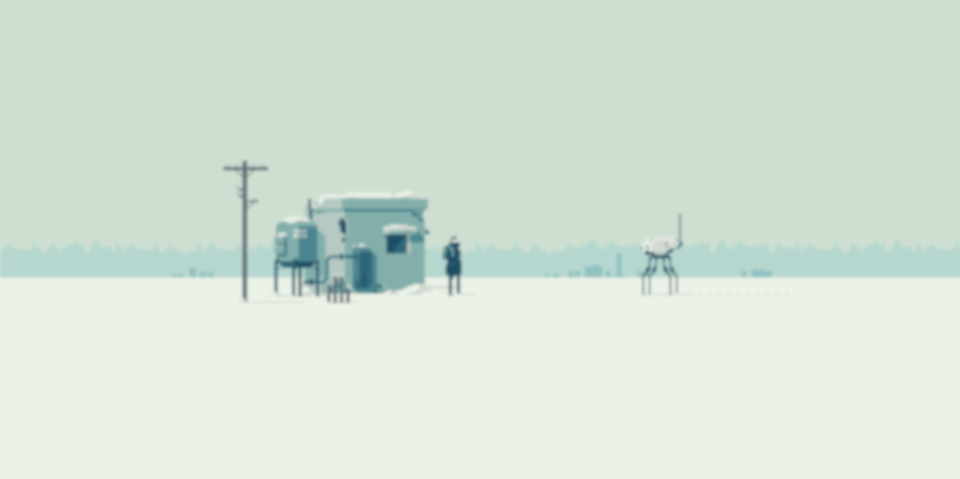



TEXTURE
by Press F to Backprop
>
A Text-Driven Adventure Game guided by an AI Companion

Slide 2

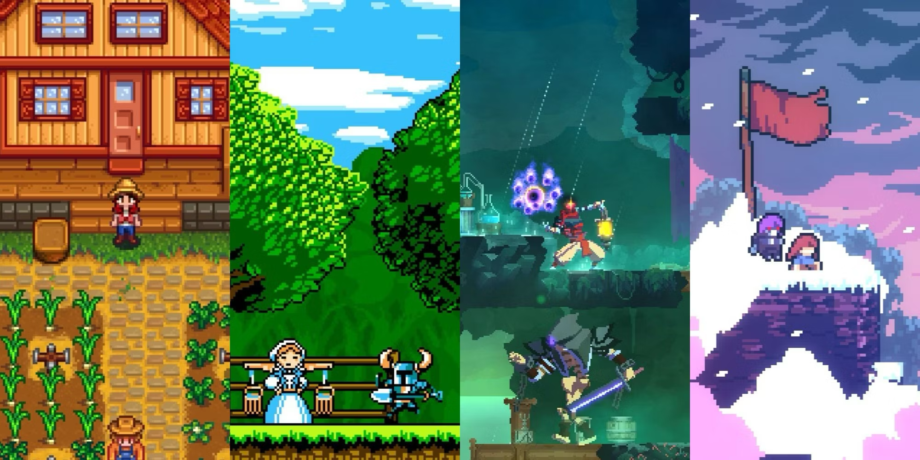
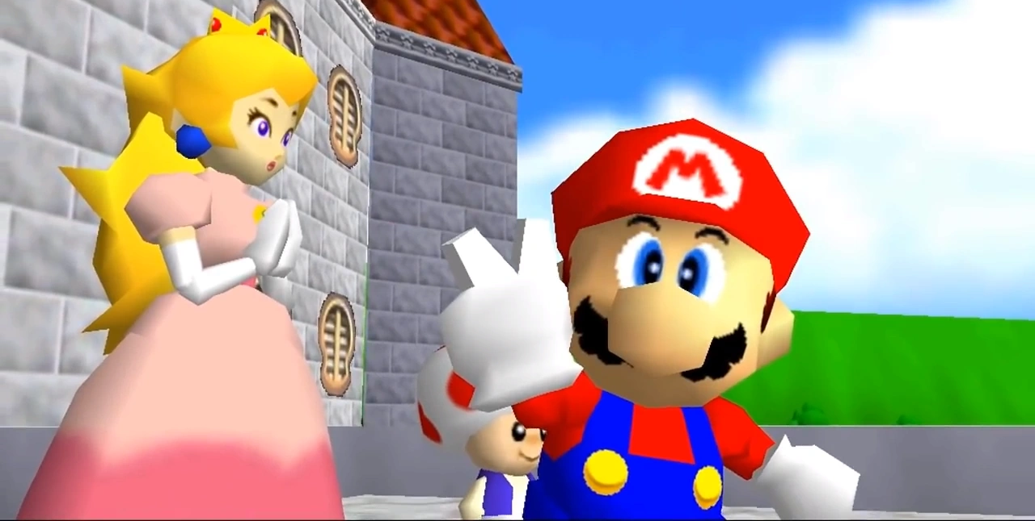
Gaps in Interactive Storytelling
Lack of Personalization
Limited Interactions
Narrative Tradeoffs
Predictable Story Arcs

Slide 3
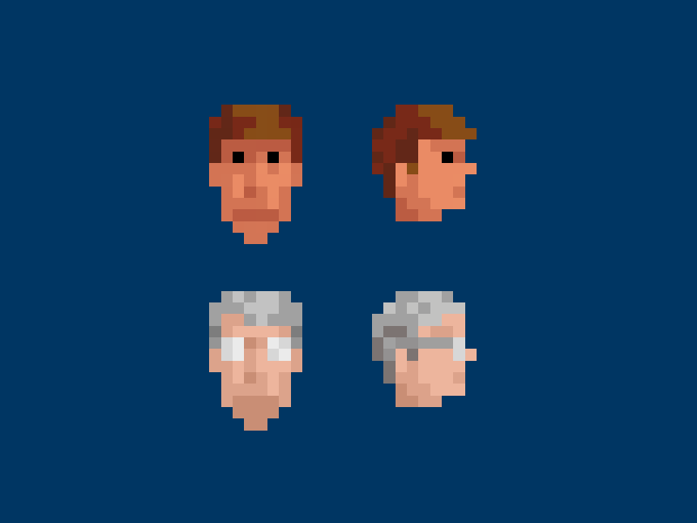


Value Proposition
User Customizability
Endless Replayability
AI Driven Storytelling
AI Act & GDPR Compliance
Third-Party Independent

Slide 4
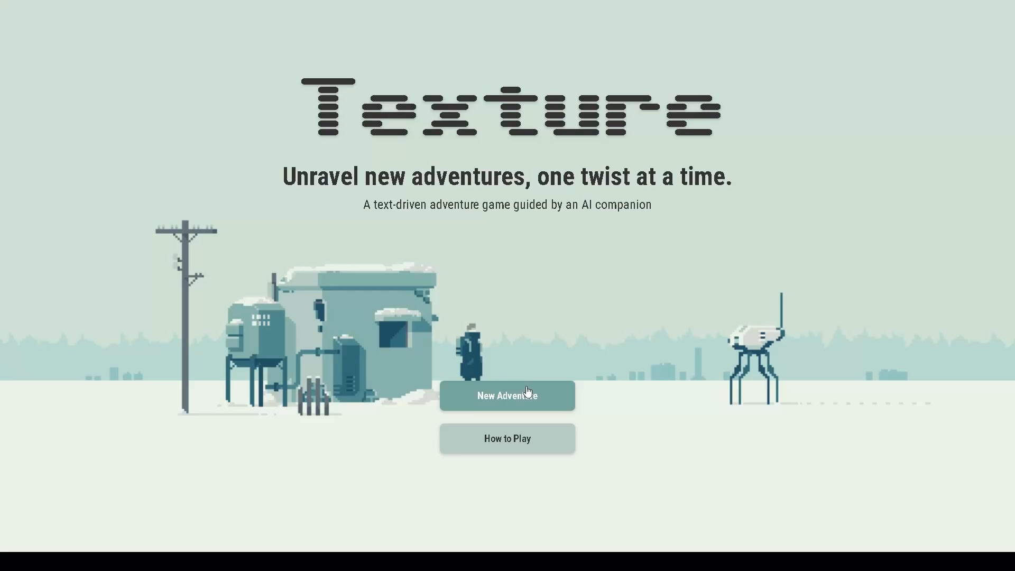
Proof Of Concept (POC)

Slide 5

Monetization
Freemium Model
B2C
Subscription Plans
One Time Purchases
$15/Month
$5/Story Continuation
First Month Free
UGC Marketplace

Slide 6
KPI advantages
User purchases
Content sharing
Social interactions
Playing time
Content creation time
Retention rate

Slide 7




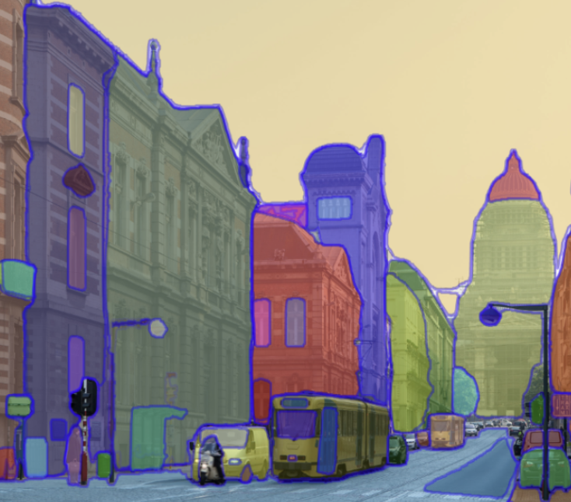


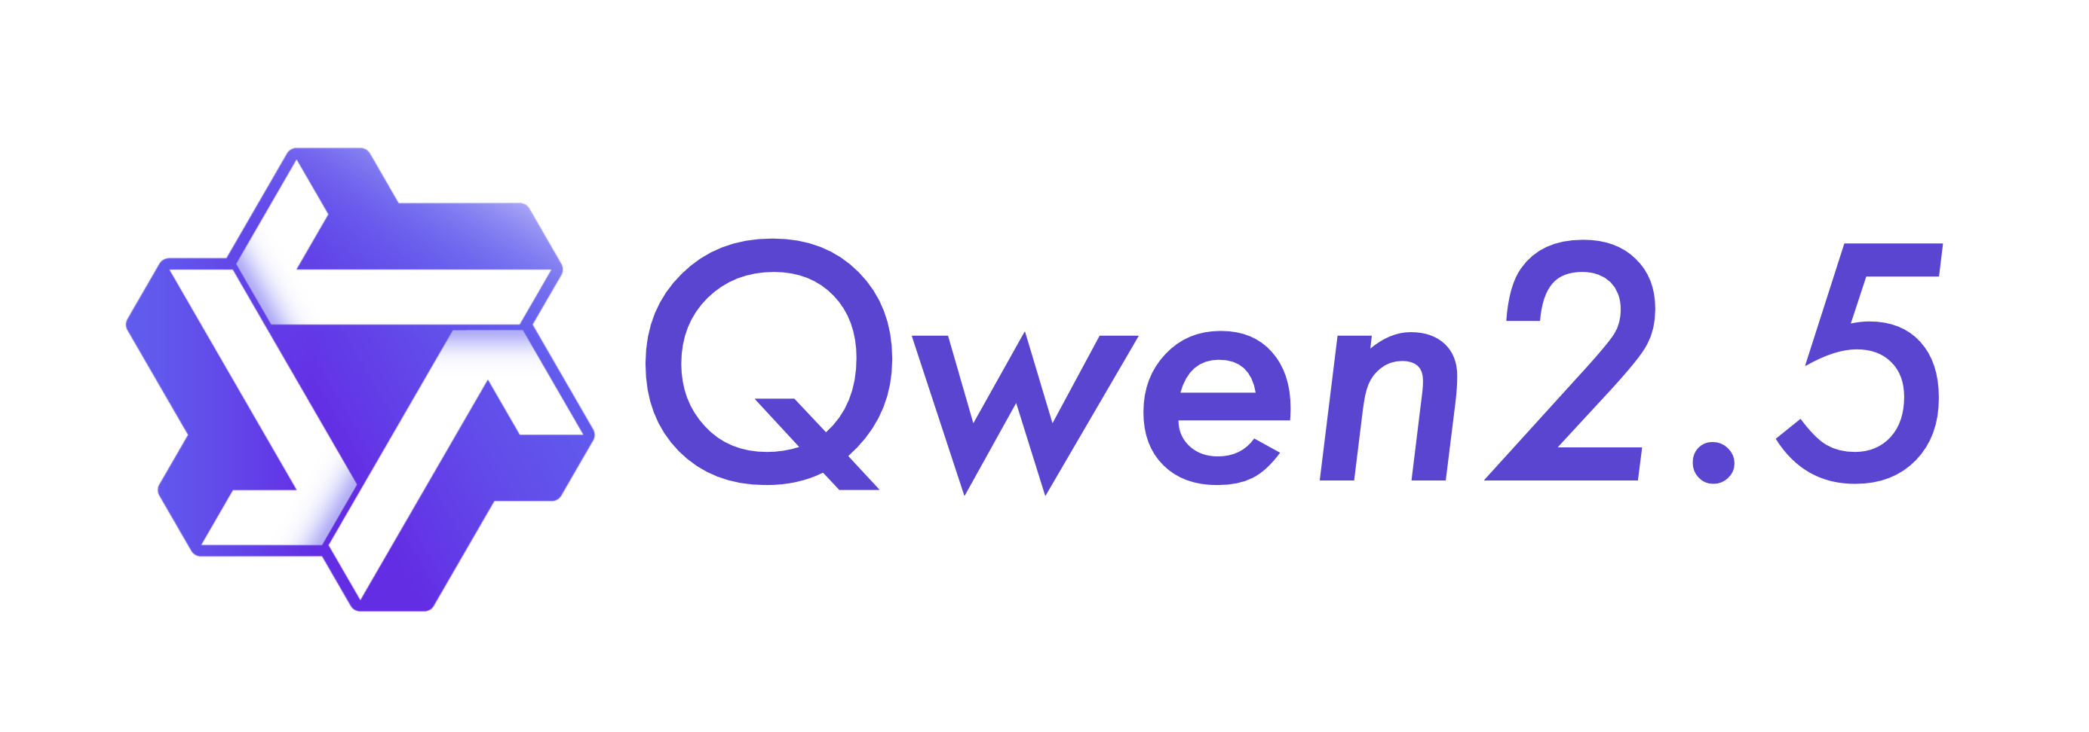
Technology
SAM

Slide 8

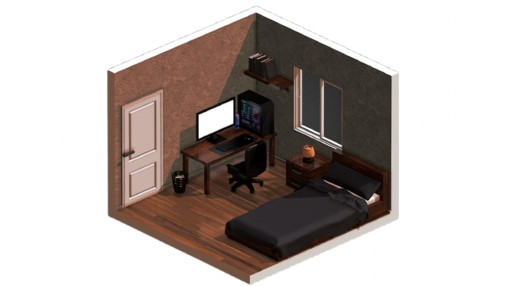




AI Pipeline
Riddle Master
User Character Description
Stable Diffusion
Scene Understanding
LLM Scene Description
SAM
Stable Diffusion
LLM
Chat Based Game

Slide 9
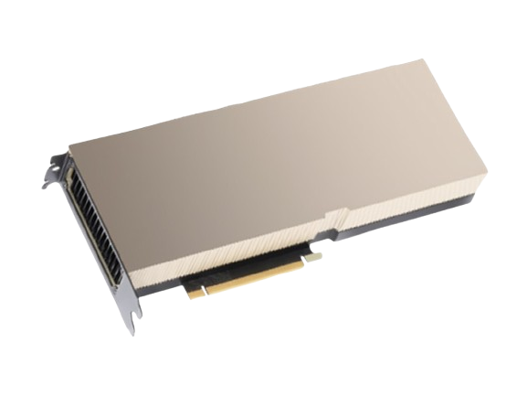
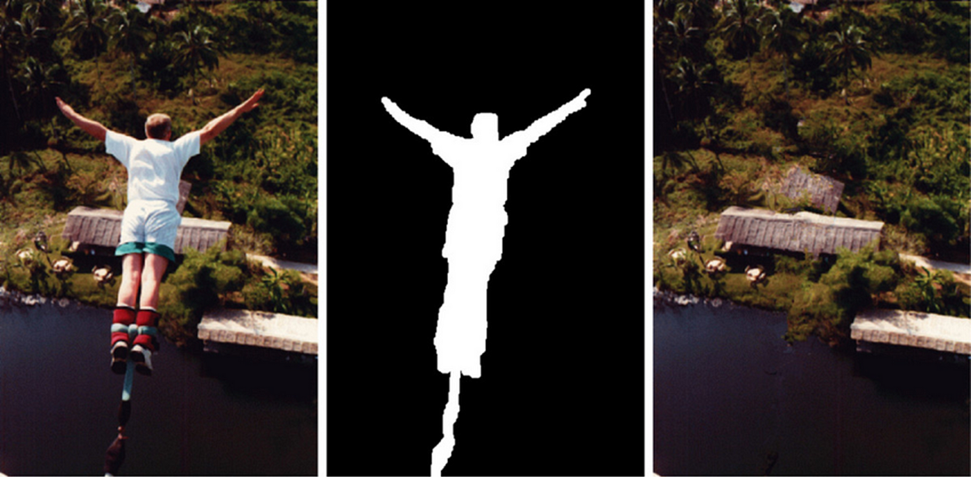
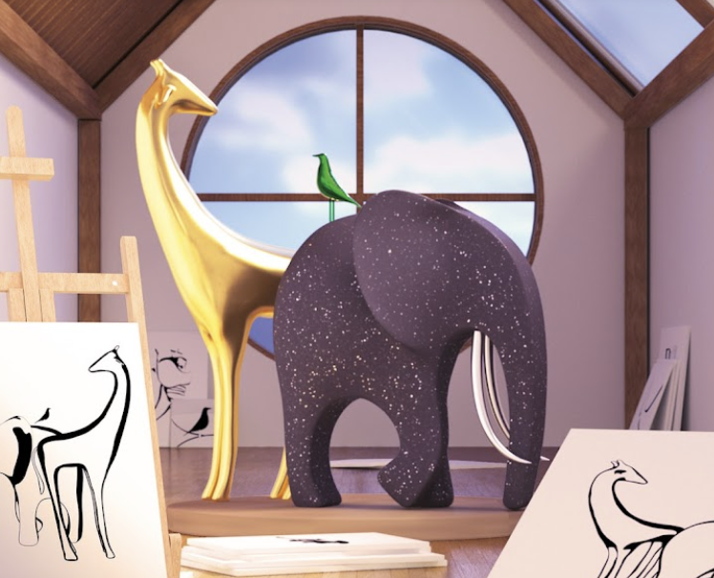
Observed Limitations
Heavy Reliance on Hardware
Image Inpainting Difficulties
Stylized World Generation

Slide 10
Our Vision

Slide 11
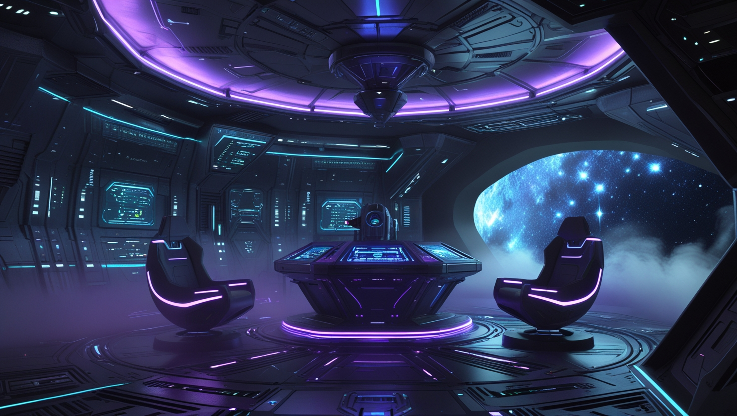
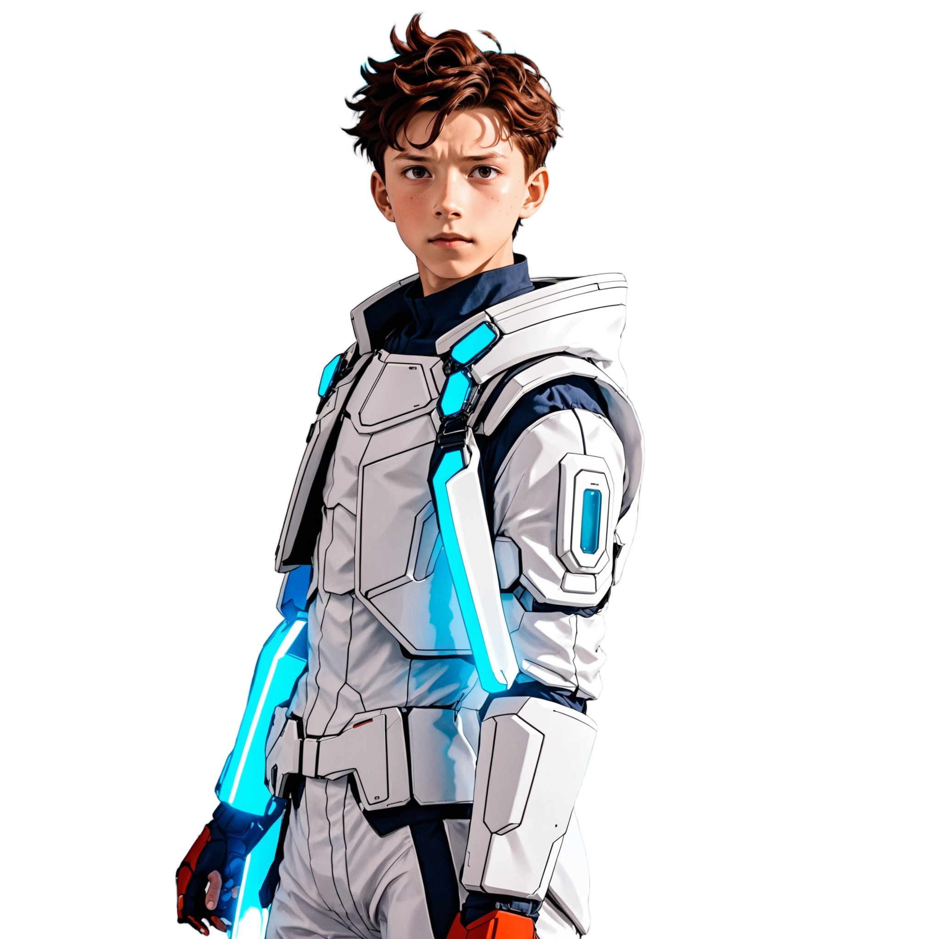
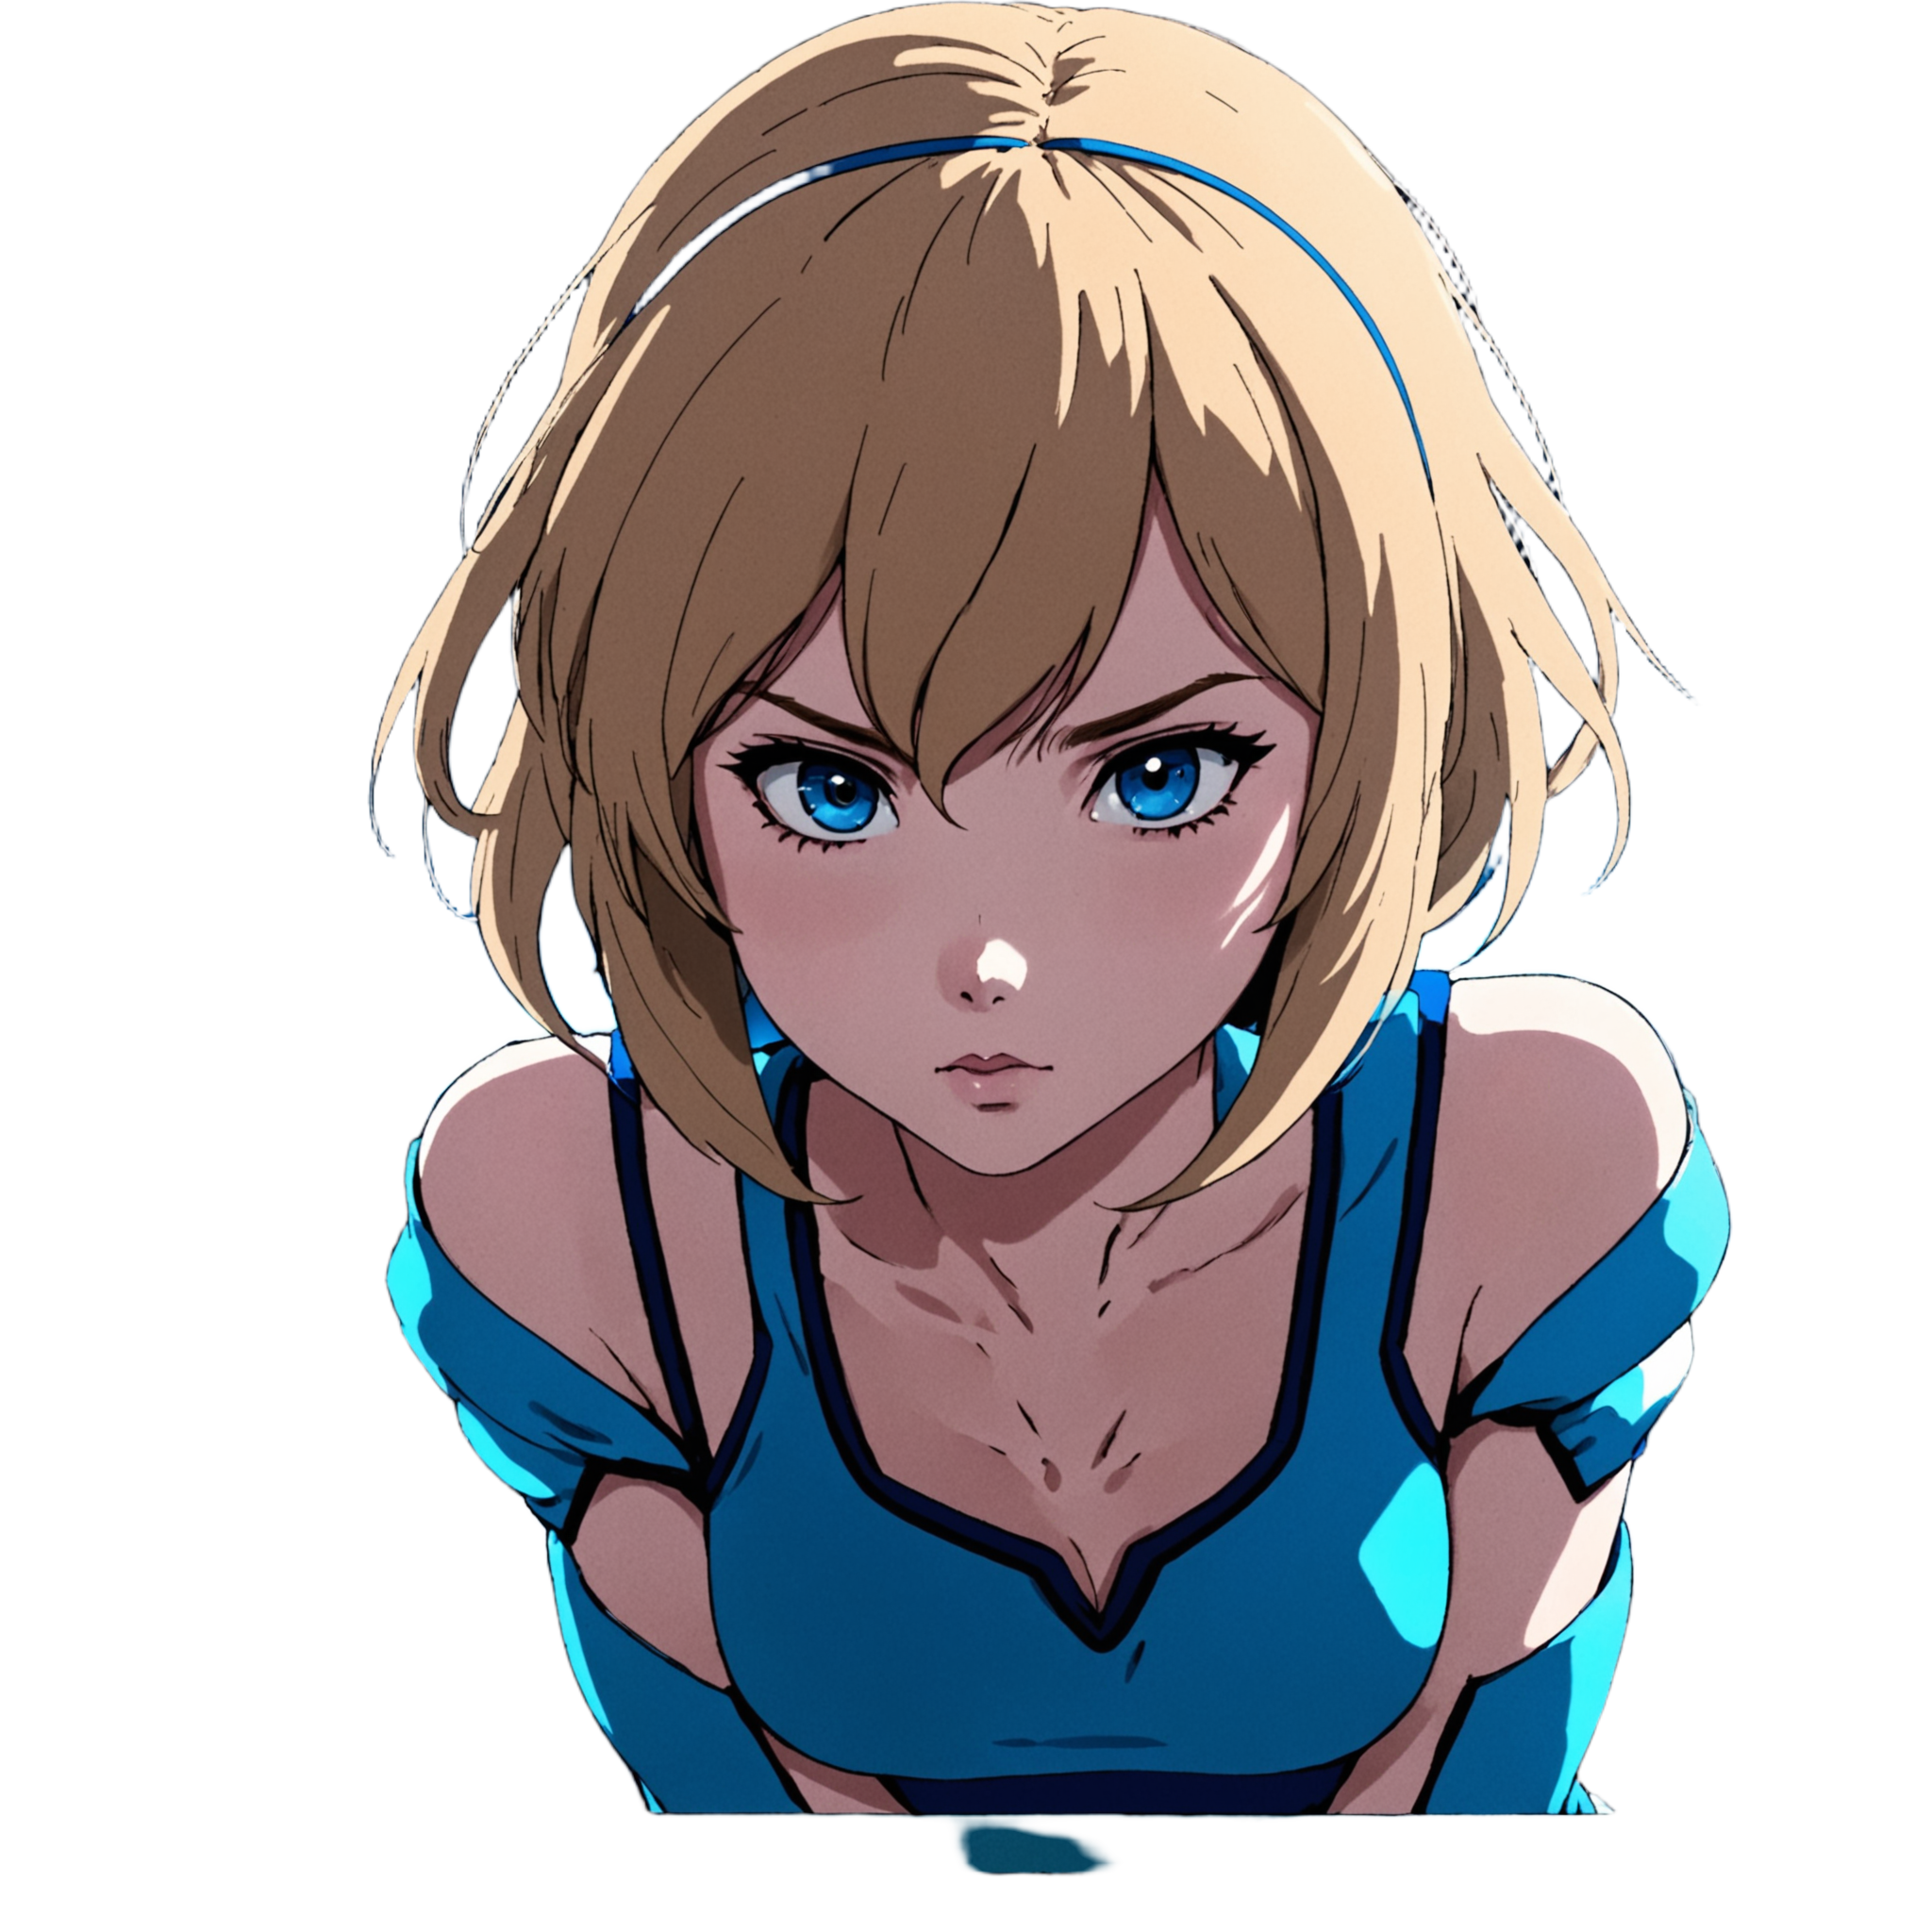
Fully AI Generated Scenes
What are you doing here?
You
Swifty
Checking for intruders
I was missing you
Leave me alone!

Slide 12
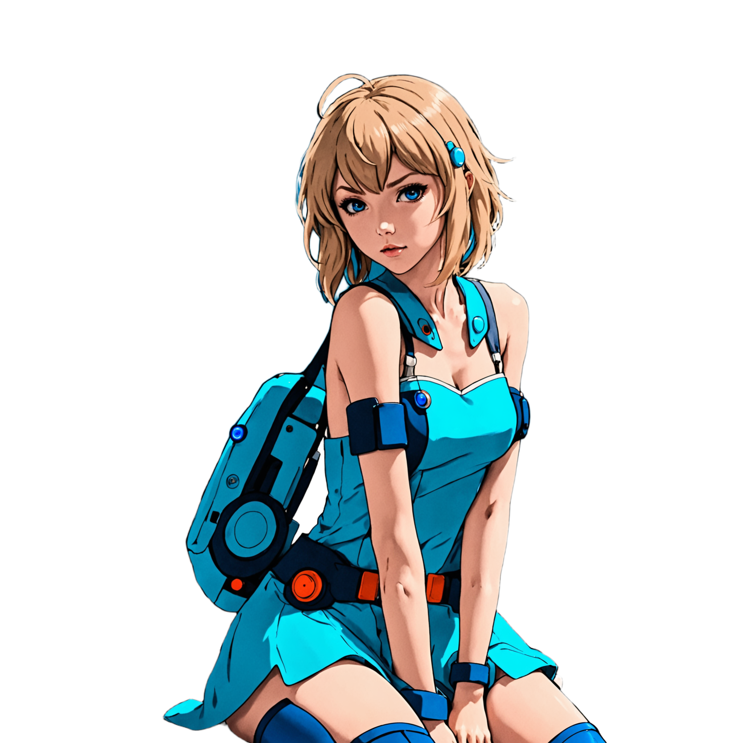
Coherent character designs
You are such a sweet guy!
You
Swifty

Slide 13

Interacting with the environment
Space bar
Engine room
You
Swifty
Change destination
Check logs

Slide 14
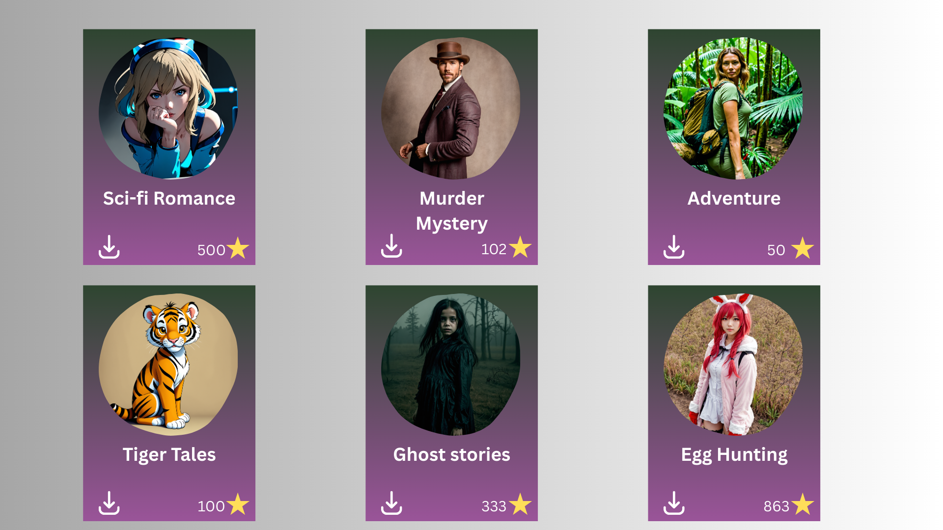
User Generated Market

Slide 15
Karaköse Kaan, Molnár Imre, Takács Tamás, Csibi Zsolt, Szász Milán
Thank you for having us!

